Slide 1
UNIVERSITY OF MONTENEGRO
FACULTY OF CIVIL ENGINEERING
PODGORICA, MONTENEGRO
Goran Sekulić
University of Montenegro
Kick-off meeting/ 20 December 2018
This project has been funded with support from the European Commission. This publication reflects the views only of the author, and the Commission cannot be held responsible for any use which may be made of the information contained therein.

Slide 2
UNIVERSITY OF MONTENEGRO
ONLY PUBLIC/STATE UNIVERSITY IN MONTENEGRO
44 YEARS OLD, WITH SEVERAL OLDER FACULTIES
COMPREHENSIVE UNIVERSITY, COVERING ENGINEERING, NATURAL SCIENCES, MEDICINE, SOCIAL SCIENCES, HUMANITIES AND ARTS
19 FACULTIES + 2 INSTITUTES,
LOCATED THROUGHOUT MONTENEGRO
21 000 STUDENTS ( > 70% STUDENT POPULATION)
BOLOGNA DECLARATION IMPLEMENTATION – SINCE 2003/04
Strengthening of master curricula in water resources management
for the Western Balkans HEIs and stakeholders
www.swarm.ni.ac.rs

Slide 3
Strengthening of master curricula in water resources management
for the Western Balkans HEIs and stakeholders
www.swarm.ni.ac.rs

Slide 4
Strengthening of master curricula in water resources management
for the Western Balkans HEIs and stakeholders
www.swarm.ni.ac.rs

Slide 5
FACULTY OF CIVIL ENGINEERING
STAFF: 38 TEACHING + 3 LABORATORY + 8 ADMINISTRATION
TEACHING STAFF:
- 7 FULL PROFESSORS (PhD, MSc, Dipl.Ing),
- 8 ASSOCIATED PROFESSORS (PhD, MSc, Dipl.Ing),
- 6 ASSISTANT PROFESSORS (PhD, MSc, Dipl.Ing),
- 17 TEACHING ASSISTANTS (PhD or MSc, Dipl.Ing)
ADDITIONAL TEACHING STAFF:
- VISITING PROFESSORS FROM UNIVERSITIES
OF NEIGHBOURING COUNTRIS,
- VISITING PROFESSORS FROM OTHER UNITS
OF THE UNIVERSITY OF MONTENEGRO,
- PART-TIME TEACHING ASSISTANTS
Strengthening of master curricula in water resources management
for the Western Balkans HEIs and stakeholders
www.swarm.ni.ac.rs

Slide 6
FACULTY OF CIVIL ENGINEERING
STUDY PROGRAMS
(„old“ study system,
last enrolment 2016/17)
CIVIL ENGINEERING
MANAGEMENT IN CIVIL ENGINEERING
CIVIL ENGINEERING (academic studies)
3 years – udergraduate academic studies (BSc)
1 year – postgraduate specialist studies (SpecSc)
1 year – postgraduate master studies (MSc)
3 years – doctoral studies (PhD)
MANAGEMENT IN CIVIL ENGINEERING (applied studies)
3 years – udergraduate applied studies (BApp)
1 year – postgraduate specialist applied studies (SpecApp)
Strengthening of master curricula in water resources management
for the Western Balkans HEIs and stakeholders
www.swarm.ni.ac.rs

Slide 7
FACULTY OF CIVIL ENGINEERING
SPECIALISATIONS („old“ study system)
CIVIL ENGINEERING
3 y. – udergrad. studies (BSc) – GENERAL, NO SPECIALISATIONS!
1 y. – postgrad. spec. studies (SpecSc): - STRUCTURES,
- TRAFFIC,
- HYDROTECHNICS,
- GEOTECHNICS,
- MANAGEMENT
1 y. – postgrad. master studies (MSc) – AS IN PREVIOUS CYCLE
3 y. – doctoral studies (PhD) – AS IN PREVIOUS CYCLES
MANAGEMENT IN CIVIL ENGINEERING
NO SPECIALISATIONS!
Strengthening of master curricula in water resources management
for the Western Balkans HEIs and stakeholders
www.swarm.ni.ac.rs

Slide 8
FACULTY OF CIVIL ENGINEERING
STUDY PROGRAMS („new“ study system, first enrolment 2017/18)
3 years – udergraduate academic studies (BSc) - CIVIL ENGINEERING
(since 2017/18)
2 years – postgraduate master studies (MSc) –
(since 2020/21)
3 years – doctoral studies (PhD) - CIVIL ENGINEERING
(since 2017/18)
CIVIL ENGINEERING -
- STRUCTURES
CIVIL ENGINEERING -
- INFRASTRUCTURES
MANAGEMENT IN CIVIL ENGINEERING
Strengthening of master curricula in water resources management
for the Western Balkans HEIs and stakeholders
www.swarm.ni.ac.rs

Slide 9
FACULTY OF CIVIL ENGINEERING
NUMBER OF NEW STUDENTS – enrollment in the 1st year of study cycle
CIVIL ENGINEERING
3 y. – udergrad. acad. studies (BSc) – 120-130 (70 b + 50-60 sf)
1 y. – postgrad. spec. studies (SpecSc) – 50-70 (30 b + 20-40 sf)
1 y. – postgrad. master studies (MSc) – 15-20 (sf)
3 y. – doctoral studies (PhD) – cca 5 (sf)
MANAGEMENT IN CIVIL ENGINEERING
3 y. – udergrad. appl. studies (BApp) – 30-40 (20 b + 10-20 sf)
1 y. – postgrad. spec. appl. studies (SpecApp) – 10-15 (sf)
TOTAL NUMBER OF REGISTERED STUDENTS – cca 650
Strengthening of master curricula in water resources management
for the Western Balkans HEIs and stakeholders
www.swarm.ni.ac.rs

Slide 10
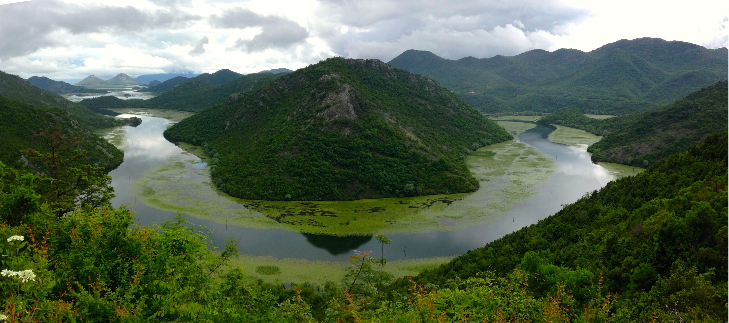
MONTENEGRO
WELCOME TO VISIT US!!!
Strengthening of master curricula in water resources management
for the Western Balkans HEIs and stakeholders
www.swarm.ni.ac.rs

